Slide 1
Internship Review
Karankumar Kumbhani (180200111066)

Slide 2

Content
Introduction
Month – I
Project Description
Month – II
Month – III
Reviews Given by Company

Slide 3
Introduction
UNNATI INFORMATICS LLP is a leading IT Solutions & Web Services provider company in Ahmedabad, India.
Company have various experts who are working on website design, software development, SEO as well as mobile app development.
Its expertise is in creating websites according to client’s vision and requirements.
Company’s target is to give client the power to accomplish their dreams with company’s amazing ideas and team. It promise to meet their expectations and provide the best solution as per client’s need.
It develop user-friendly website designs, mobile applications, digital marketing, school management software. It have extended its facilities and services in Australia, UK, USA, New Zealand, and Canada.
UNNATI INFORMATICS LLP is not just a team of professionals, it’s a family of talented, experienced, and caring individuals who are ready anytime to serve client and their specific needs.
http://unnatiinformatics.com/

Slide 4
Month - I
In starting of the internship, before assign a project to us company wants to check our basic coding languages and coding experience and also check our Logic.
So first of all company give us a task which name is Bank desktop Application using C Language, Hotel Menu using C++, Calculator using basic Java.
To interact with user (UI), build HTML and CSS Login Page for Demo and MySQL Server.
Screen shots of Above Tasks:

Slide 5
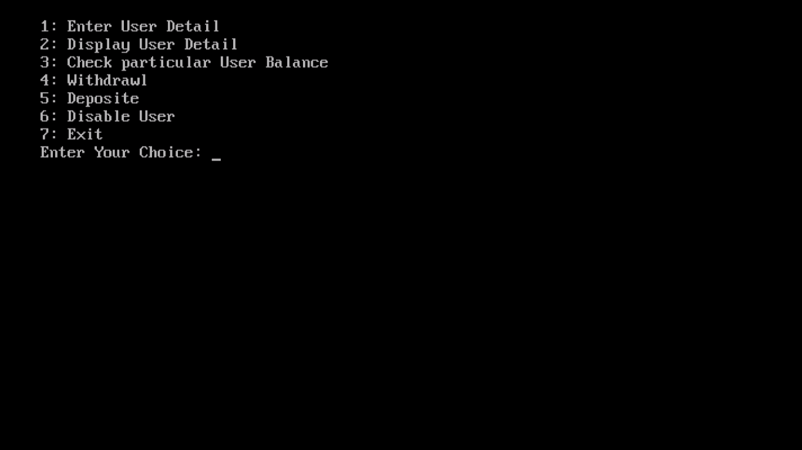
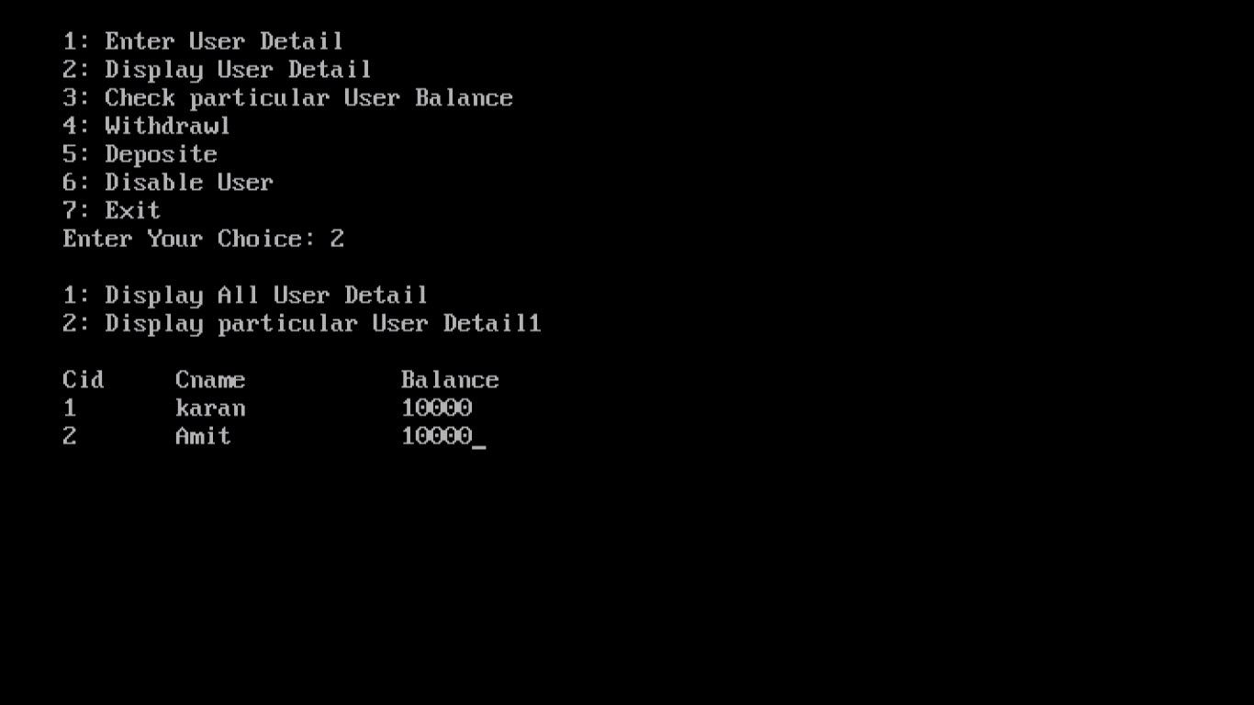
Bank Desktop Application

Slide 6
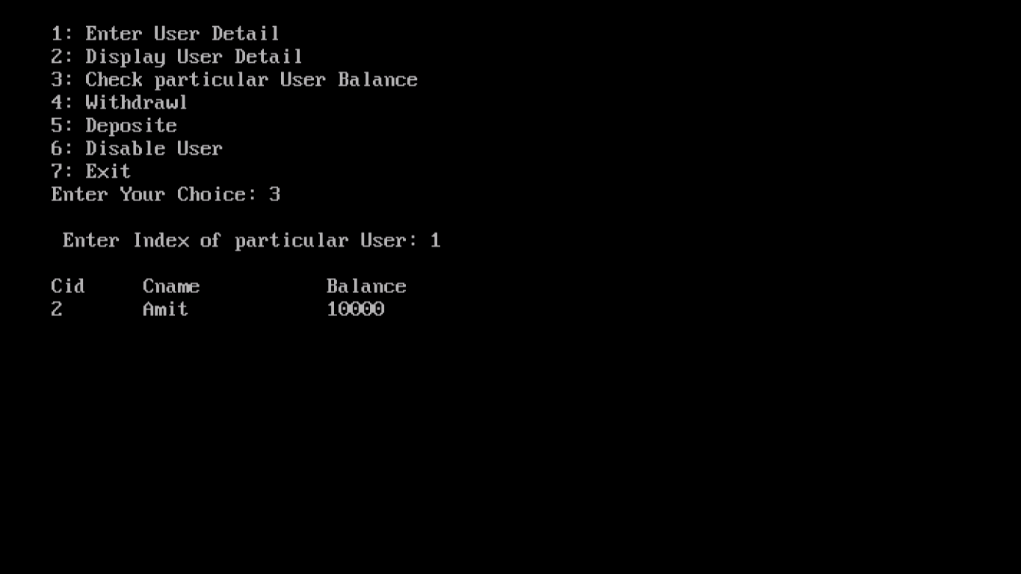
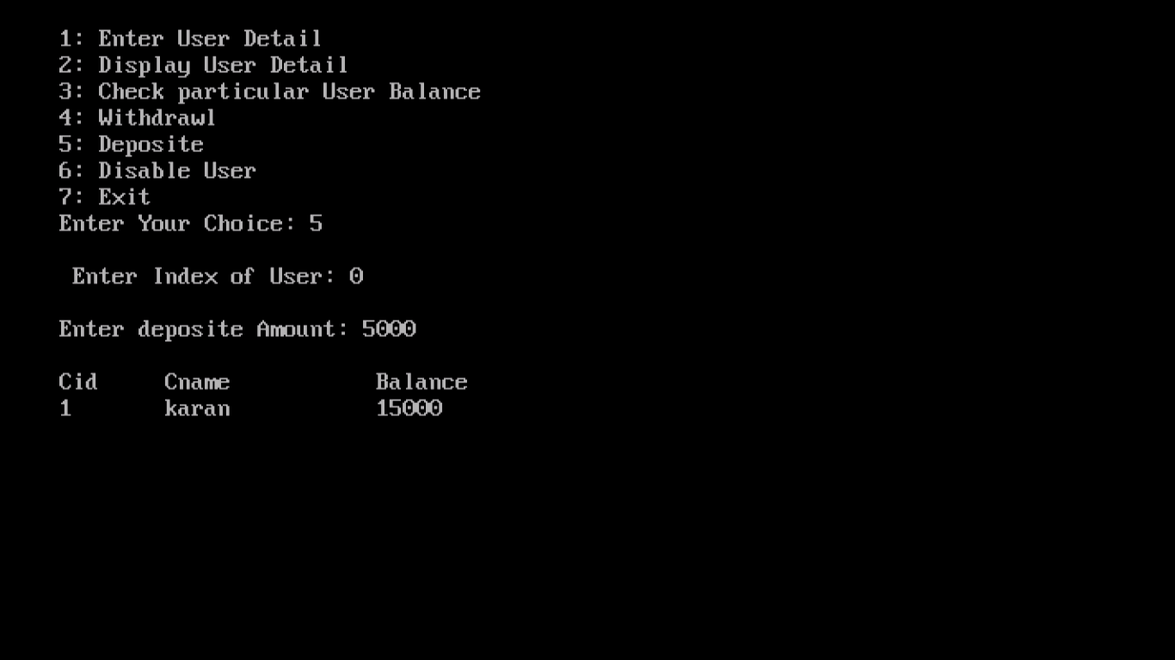
Bank Desktop Application

Slide 7
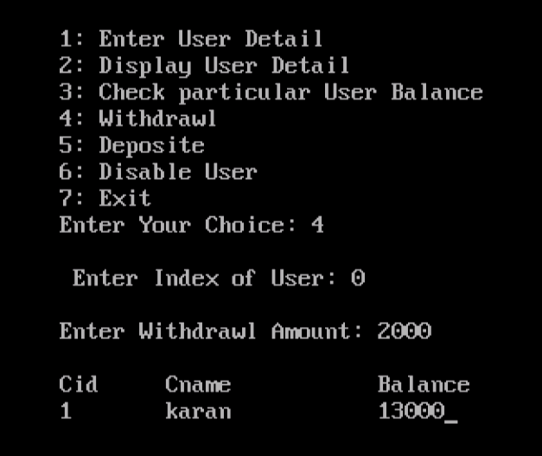
Bank Desktop Application

Slide 8
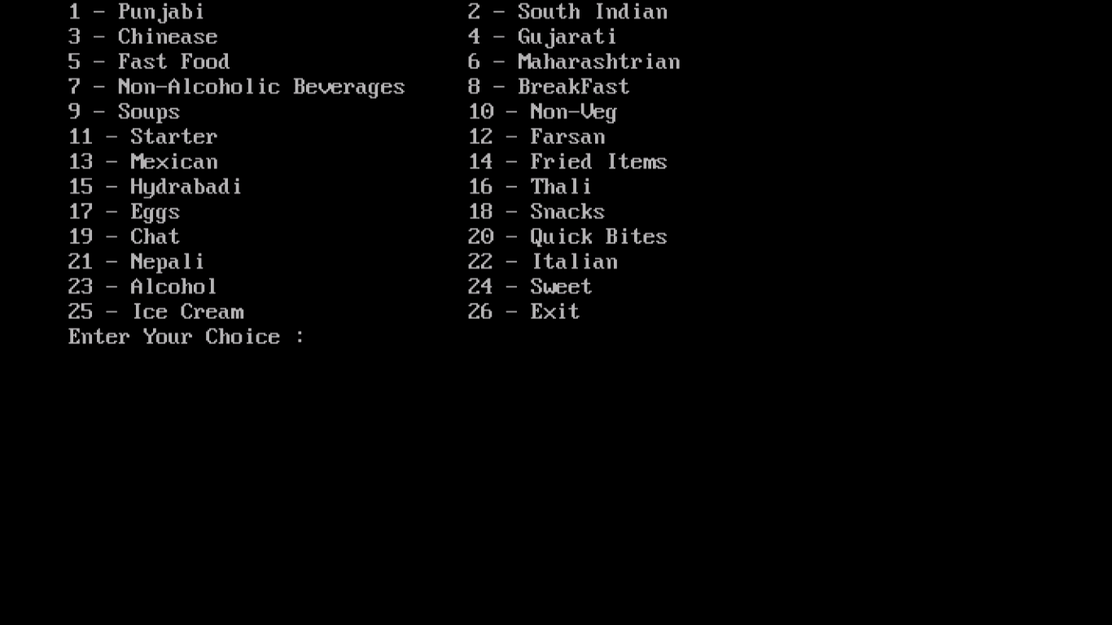
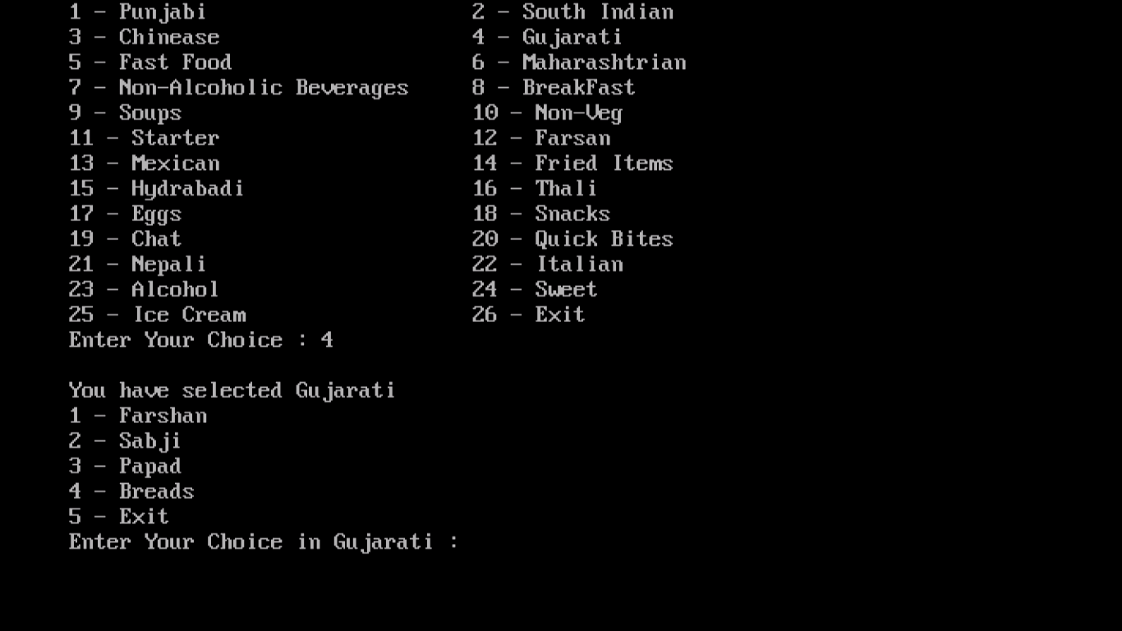
Hotel Menu

Slide 9
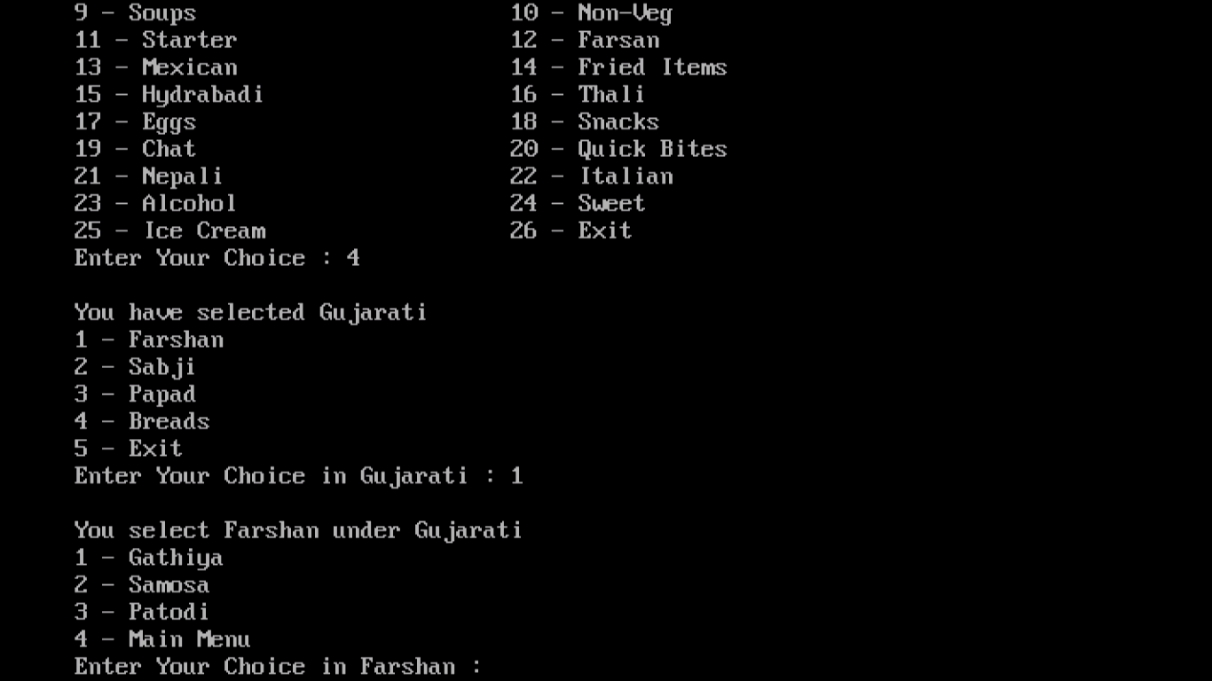
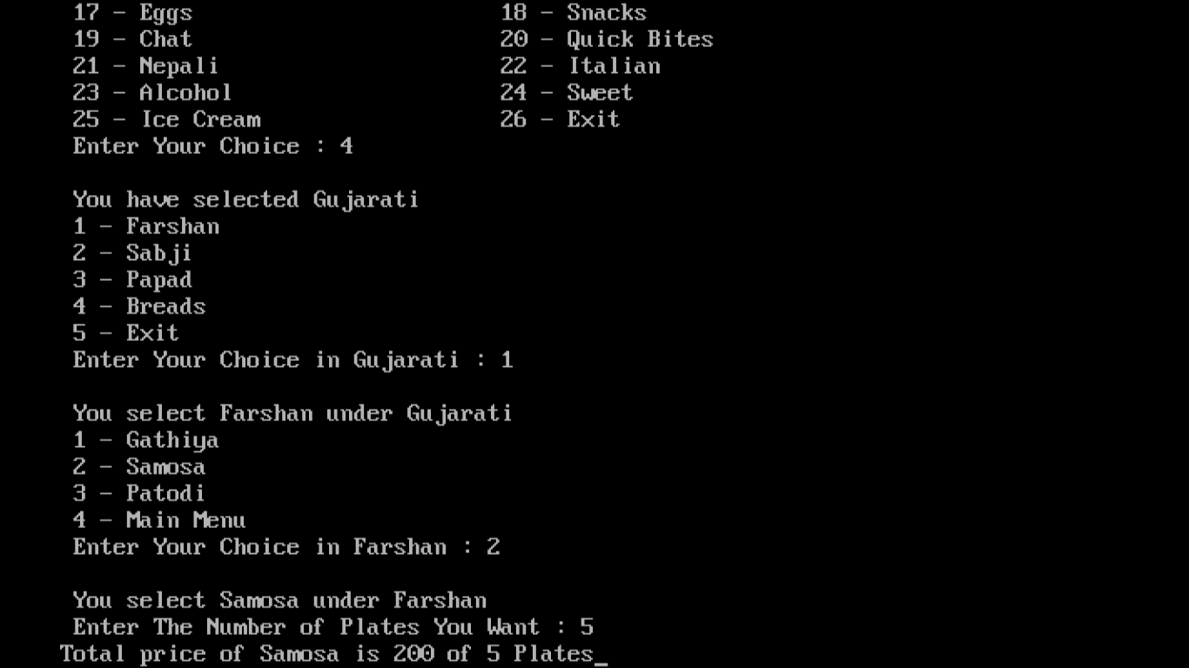
Hotel Menu

Slide 10
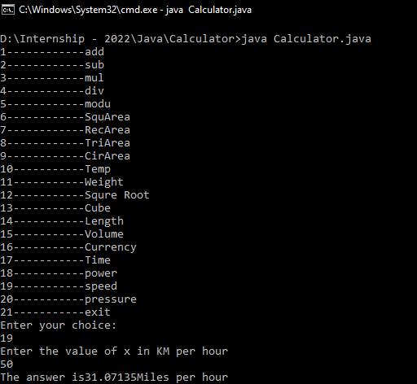
Calculator

Slide 11
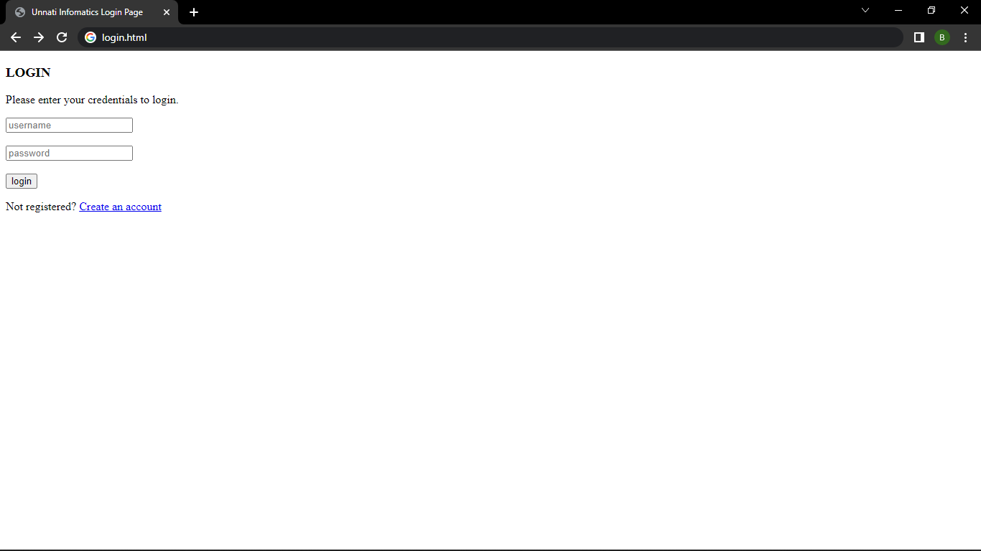
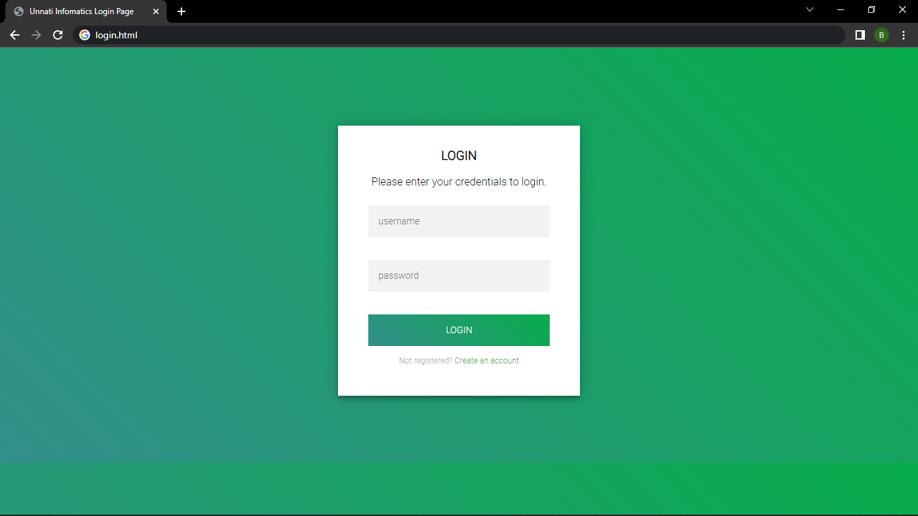
Login Page - Demo
HTML Login Page with CSS

Slide 12
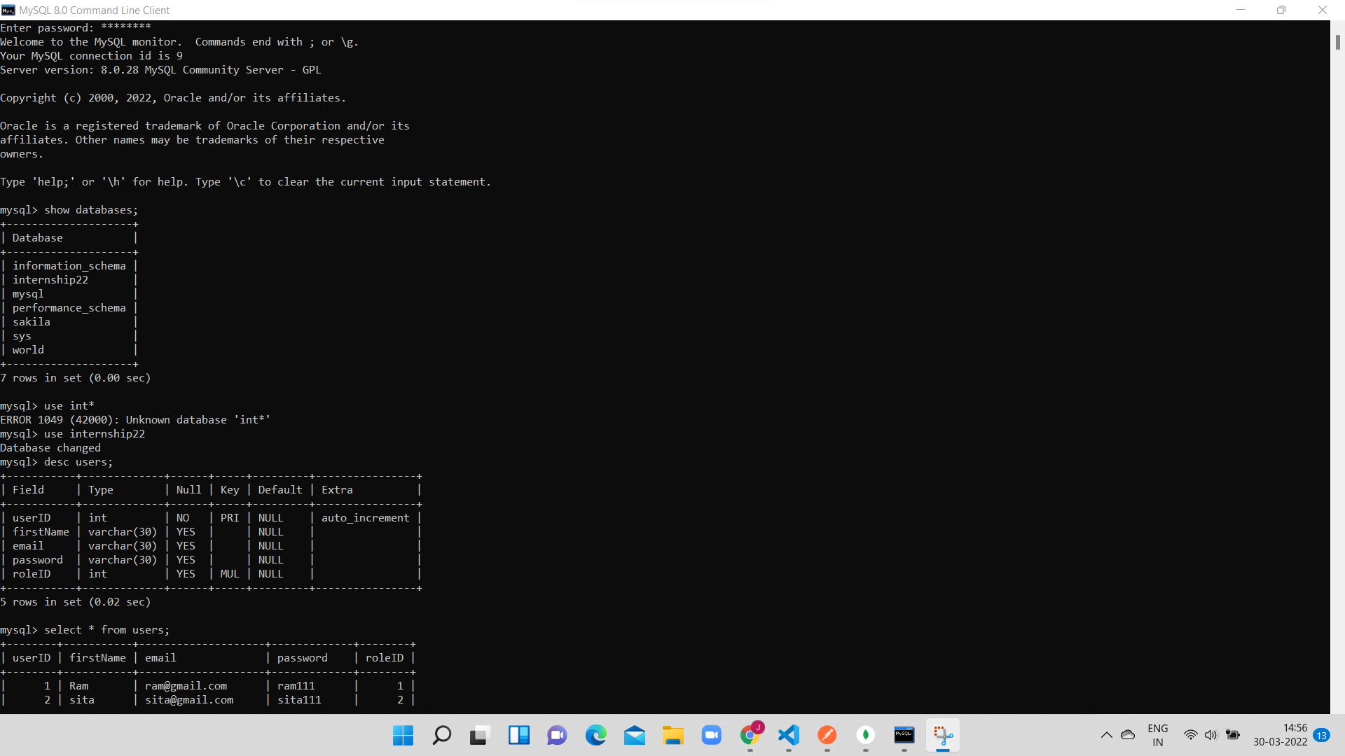
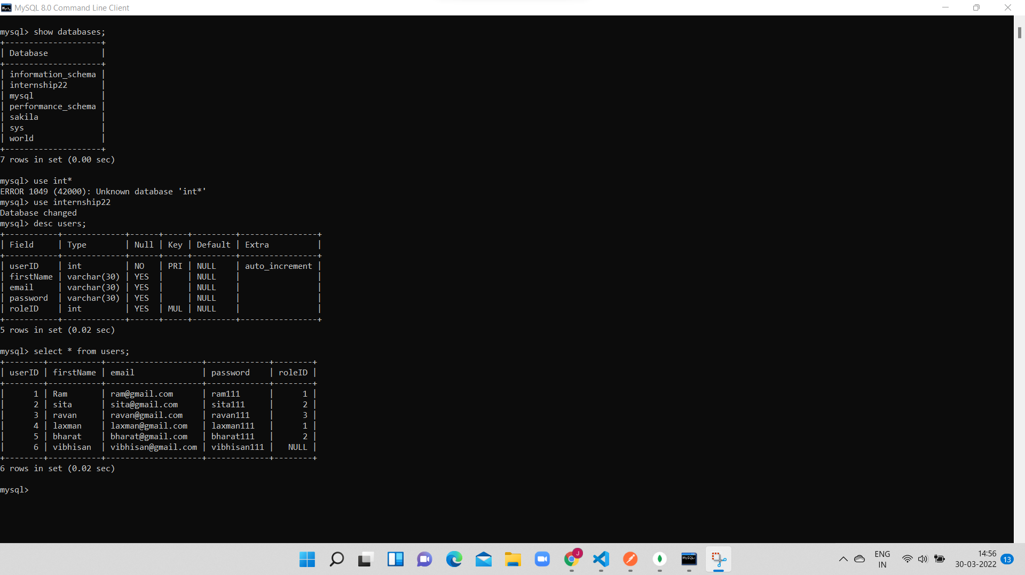
MySQL Database

Slide 13
Project Description
Bug tracking system is an app that manages all the bugs in the product.
Bug is very difficult mange for long term or in long duration project. This app let team updated with all the bugs and their status with latest build.
This app will track every developers task with their total time taken for given task, total bugs in singe task and how many times tickets are assigned for bugs to the developer.
Main goal of the application is to identify the correct team members for appraisal.
Users in Project is : Admin, project manager, developer , tester
Project manager can add projects in app , they can create multiple modules and task in projects. All task - modules are assigned by project manager to developers.
Developer needs to perform all the task and submit to the tester once they are done with the task.
Tester will test the task and add comment if any bugs founds and reassign task to the developer. Developer need to fix it and reassign to tester.

Slide 14



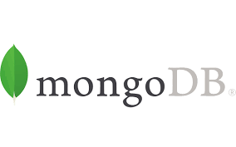

We learn and use following tools to complete Given Task by Company.

Slide 15
Month - I
Data Dictionary
A Data Dictionary is a collection of names, definitions, and attributes about data elements that are being used or captured in a database, information system, or part of a research project.
A Data Dictionary provides metadata about data elements. The metadata included in a Data Dictionary can assist in defining the scope and characteristics of data elements, as well the rules for their usage and application.
In this data dictionary we separate our project data in 9-10 different tables.
These tables contains one primary key and more than one foreign key and also contain basic data related to project.
https://docs.google.com/spreadsheets/d/1H5aMik8jhPO4sflNkZvMhzPXVTCapxKiNqhQA5X21lM/edit#gid=0

Slide 16
Month - II
User Case
A use case is a written description of how users will perform tasks on your website. It outlines, from a user’s point of view, a system’s behavior as it responds to a request. Each use case is represented as a sequence of simple steps, beginning with a user's goal and ending when that goal is fulfilled.
Benefits of Use Cases
Use cases add value because they help explain how the system should behave and in the process, they also help brainstorm what could go wrong. They provide a list of goals and this list can be used to establish the cost and complexity of the system. Project teams can then negotiate which functions become requirements and are built.
https://app.diagrams.net/#G1bCHpIrbkseujv96V9gDOY8d8Bp8apJOA

Slide 17
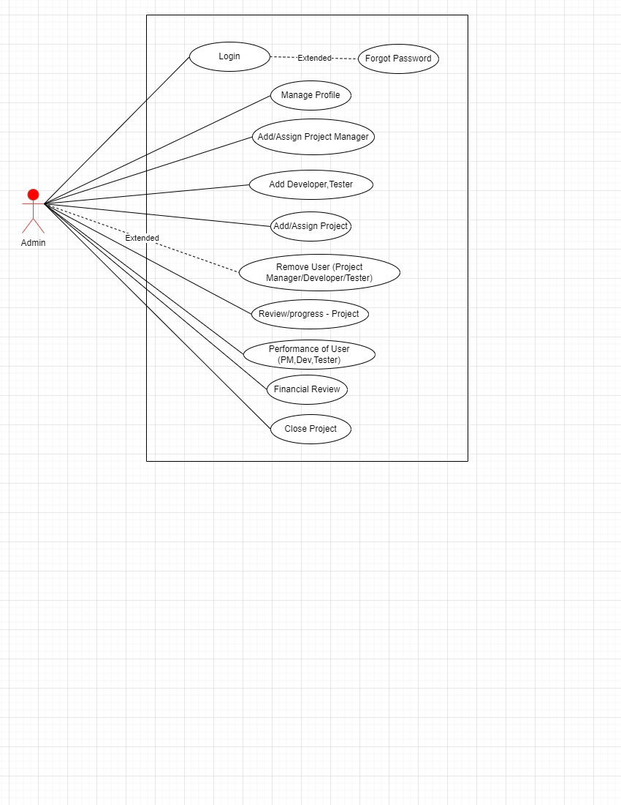
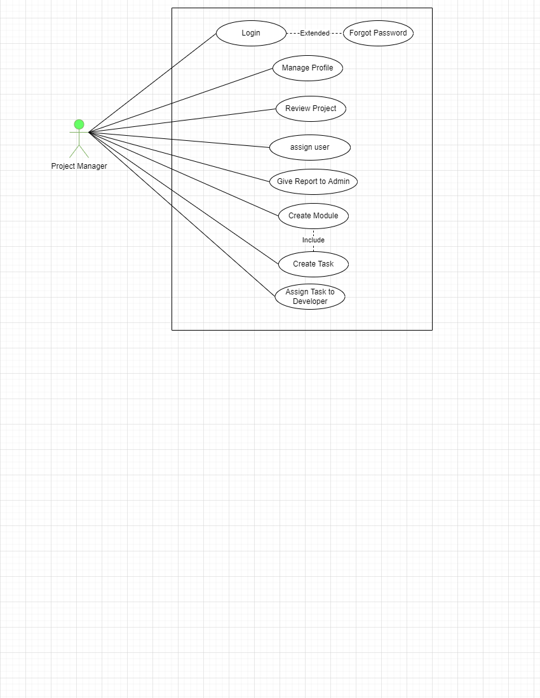

Slide 18
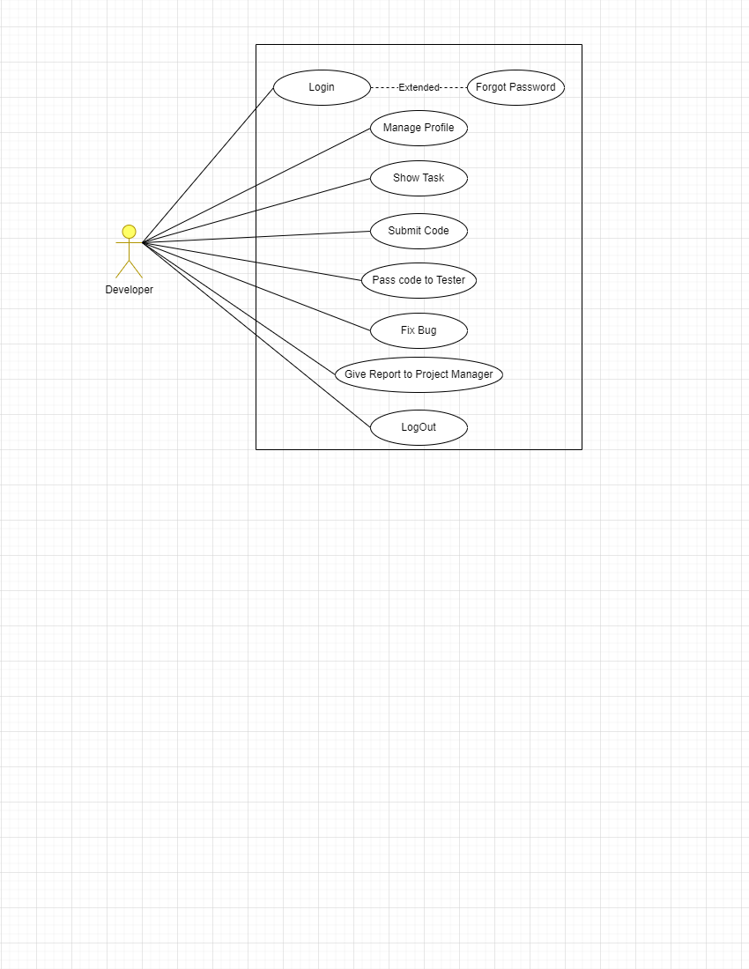
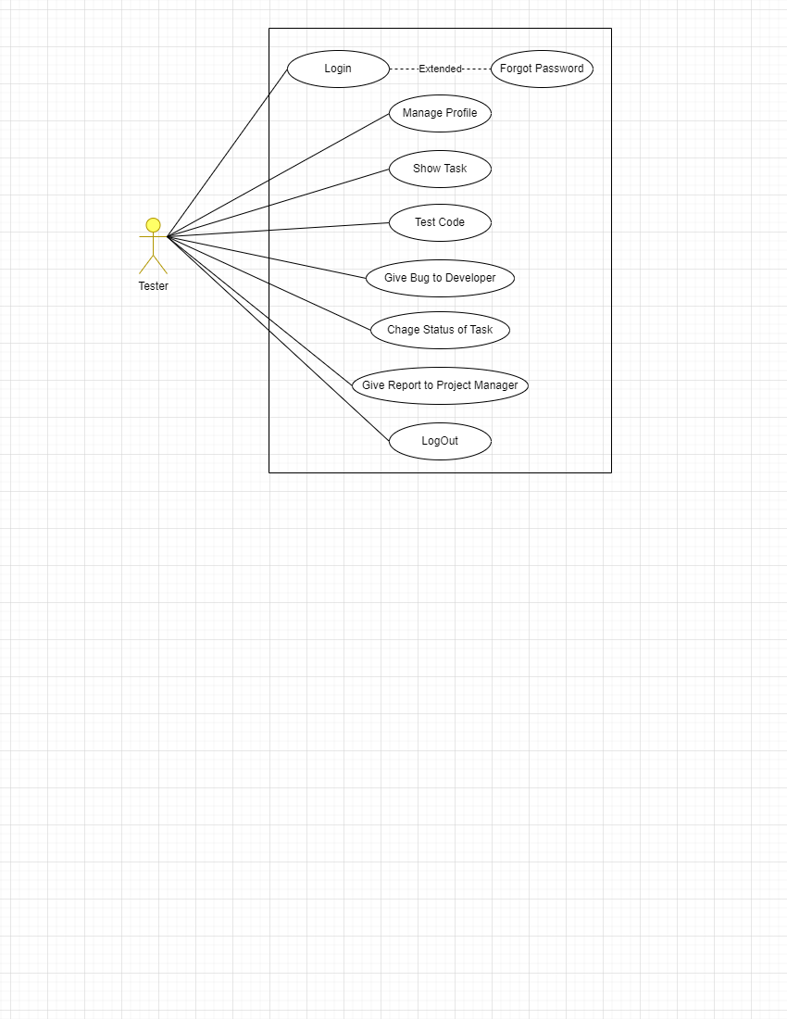

Slide 19
Month - II
Postman is a standalone software testing API (Application Programming Interface) platform to build, test, design, modify, and document APIs. It is a simple Graphic User Interface for sending and viewing HTTP requests and responses.
While using Postman, for testing purposes, one doesn't need to write any HTTP client network code. Instead, we build test suites called collections and let Postman interact with the API.
In this tool, nearly any functionality that any developer may need is embedded. This tool has the ability to make various types of HTTP requests like GET, POST, PUT, PATCH, and convert the API to code for languages like JavaScript and Python.
Screen shots: Postman where we add data related to our project.

Slide 20
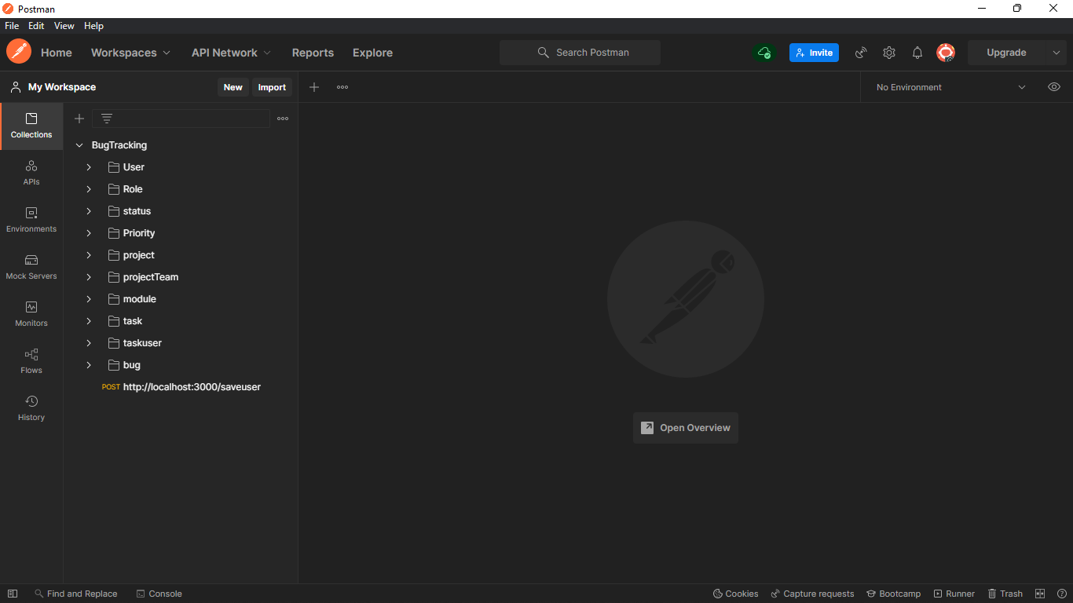
Postman: Project related All Tables

Slide 21
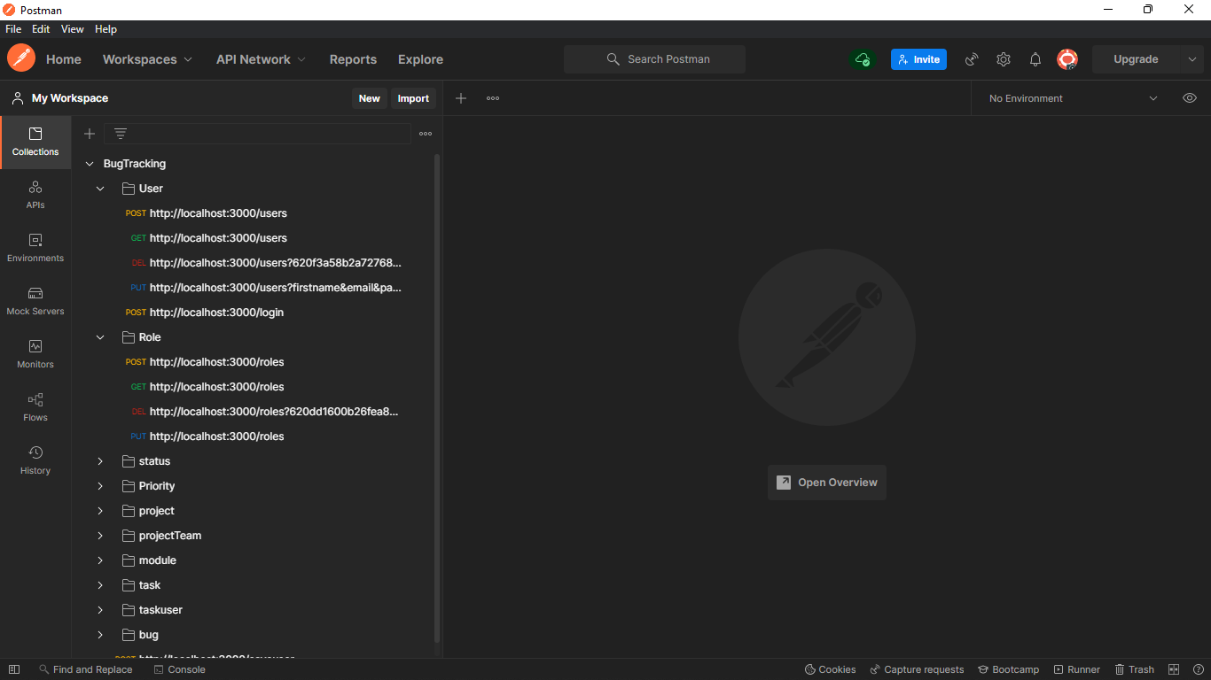
Postman: CRUD Operation on Different Tables

Slide 22
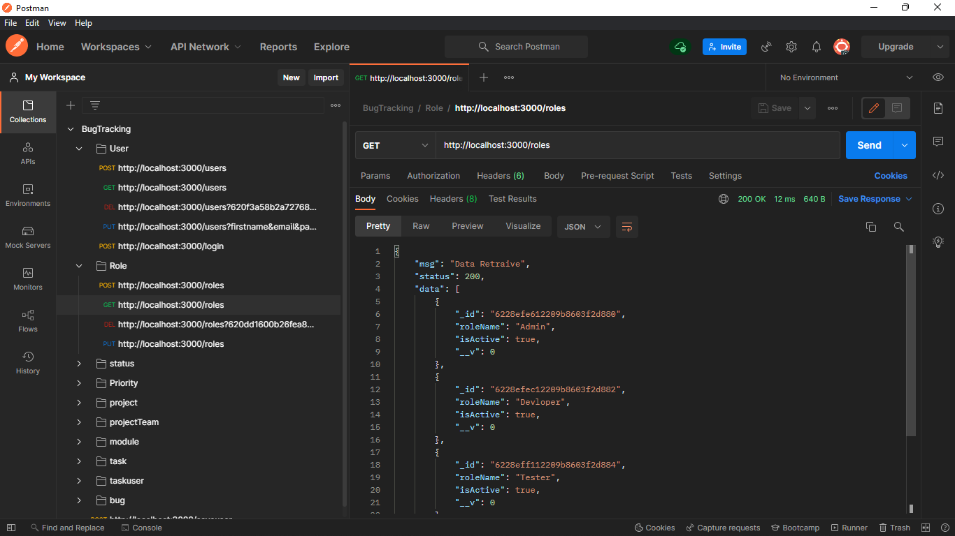
Postman: List Roles from Role Table

Slide 23
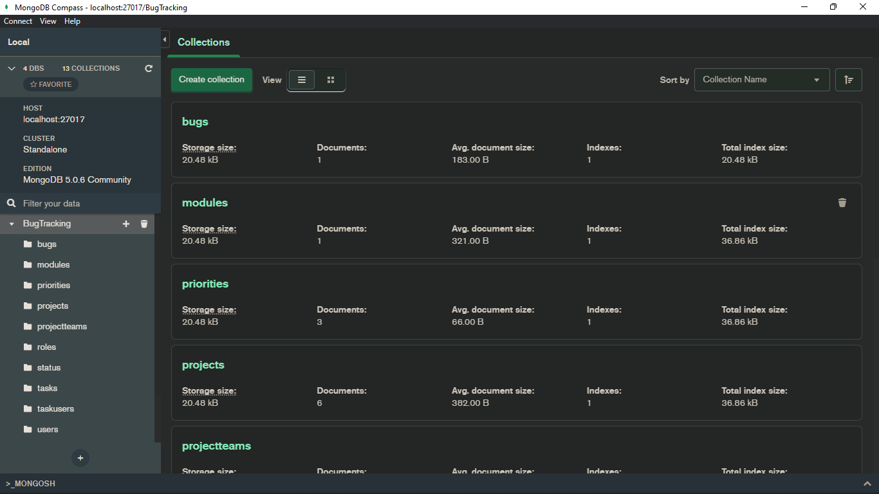
MongoDB : Project related All Tables

Slide 24
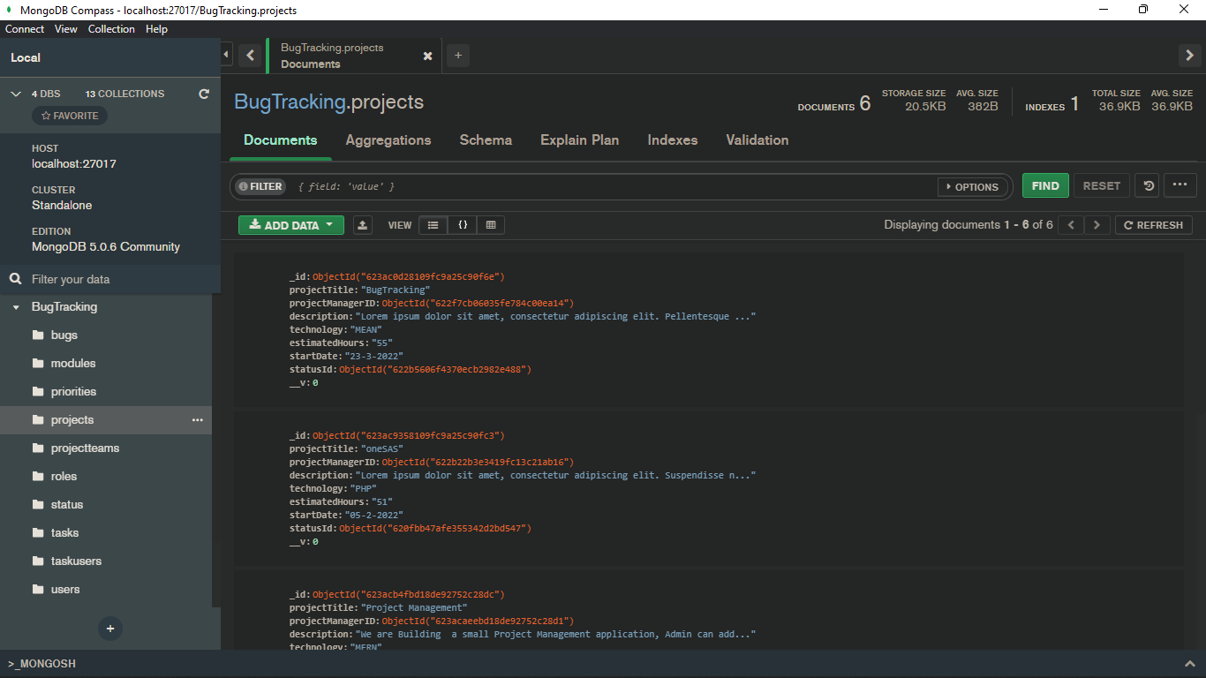
MongoDB :Project Table

Slide 25
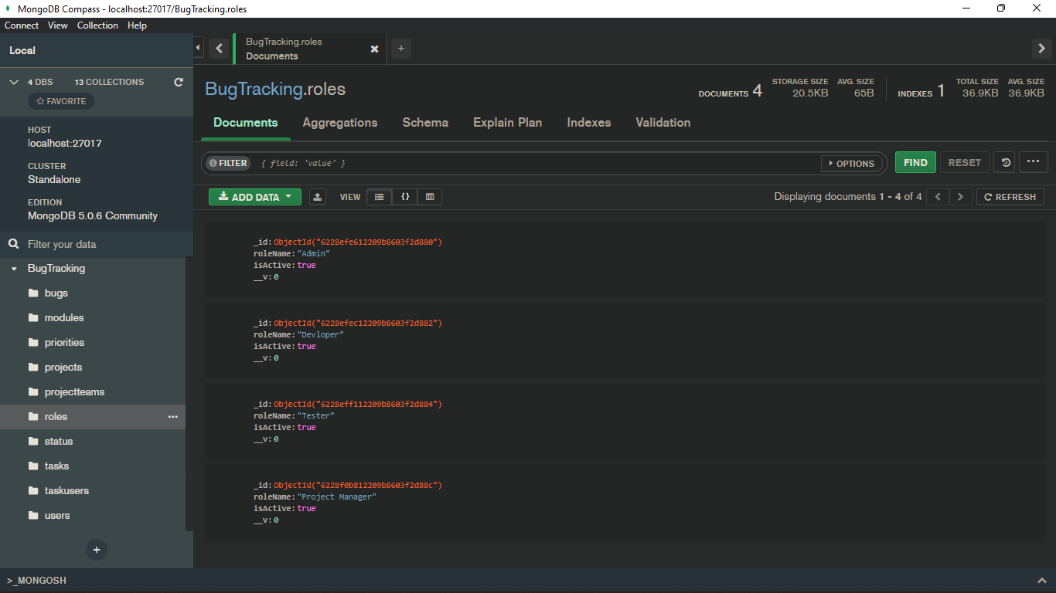
MongoDB : Stored Data of Role Table

Slide 26
Month - III
We start to Implement template on previously prepared Node API.
Firstly, we apply template on Login Page, Signup page.
Following Screenshots of project is showing process how project work.

Slide 27
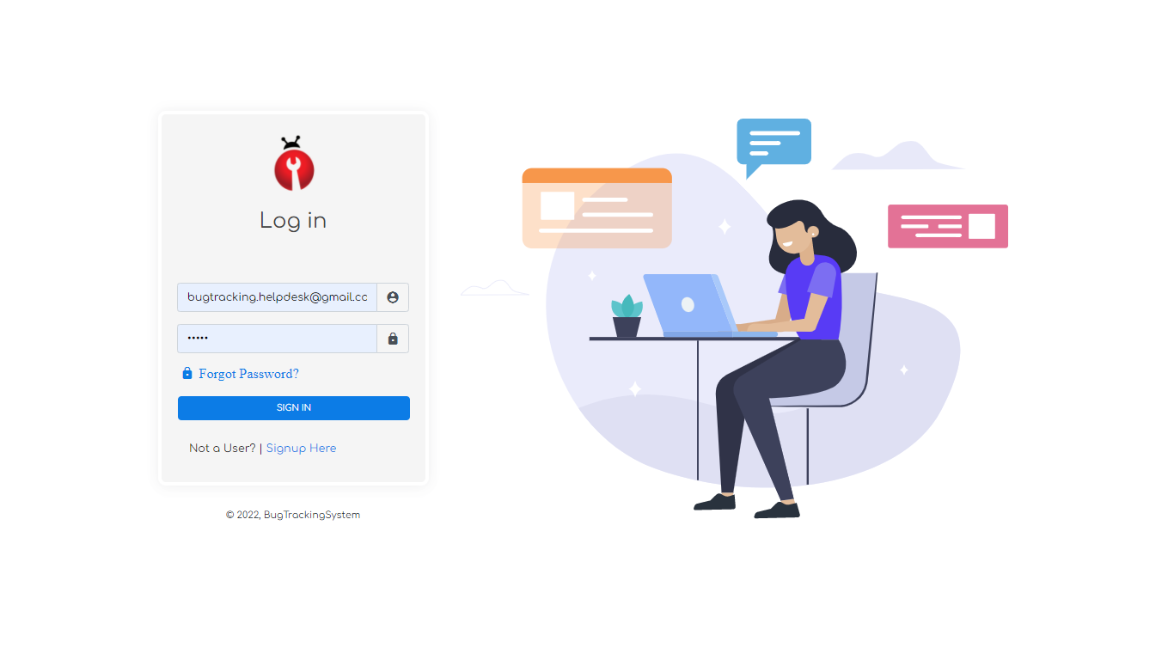

Slide 28
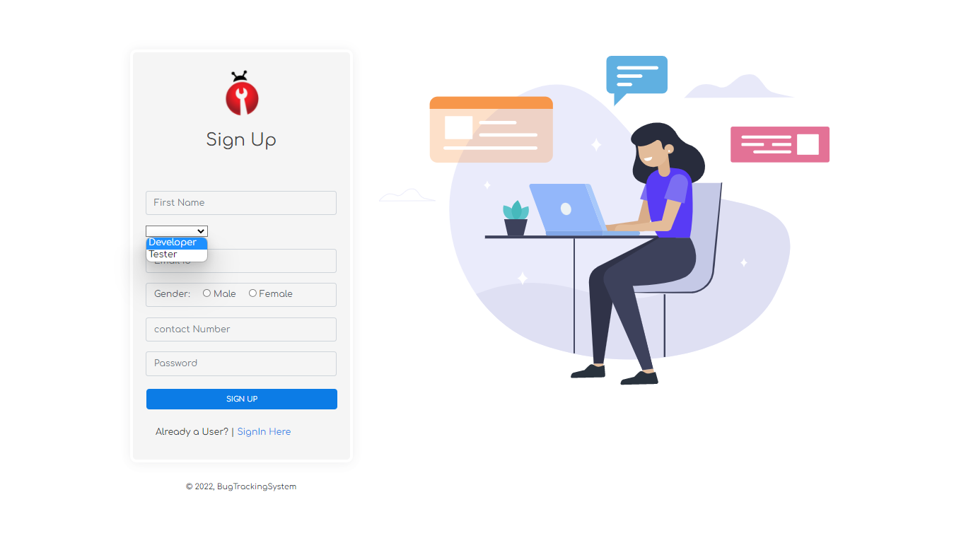

Slide 29
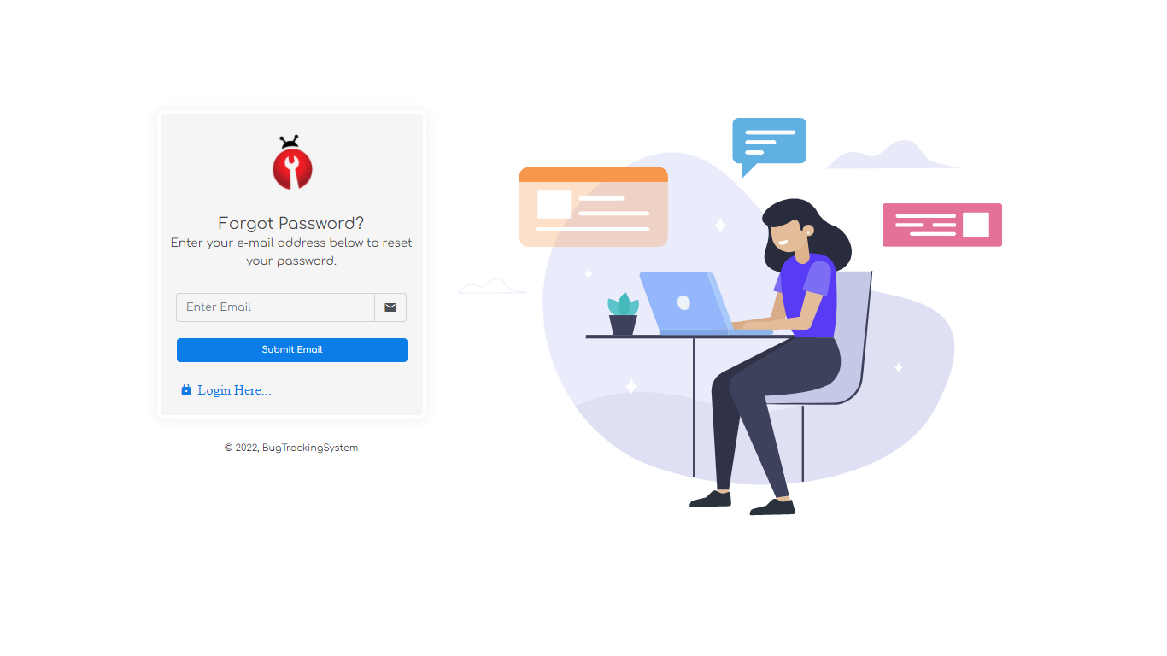

Slide 30
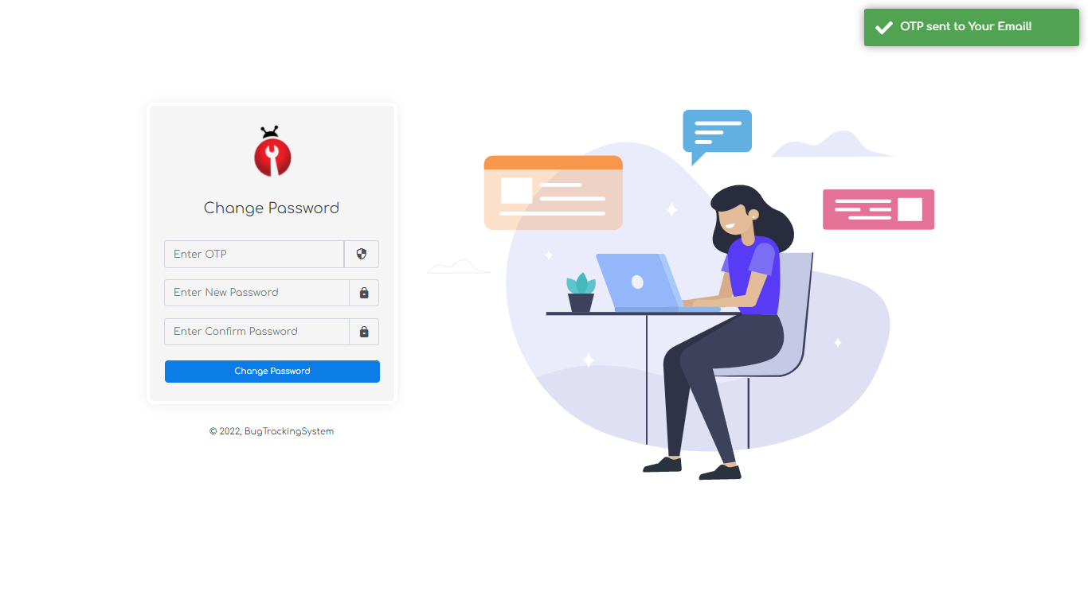

Slide 31
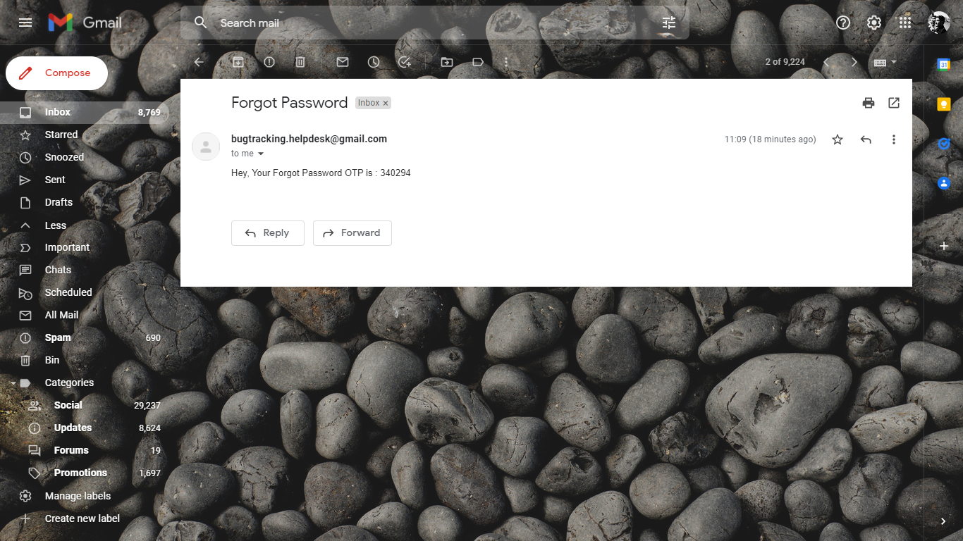

Slide 32
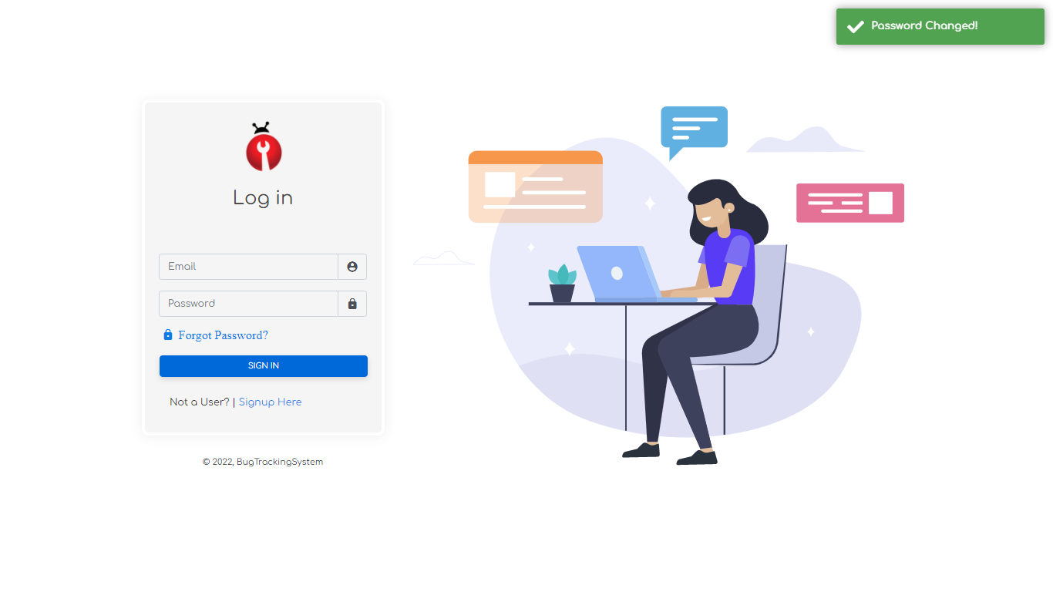

Slide 33
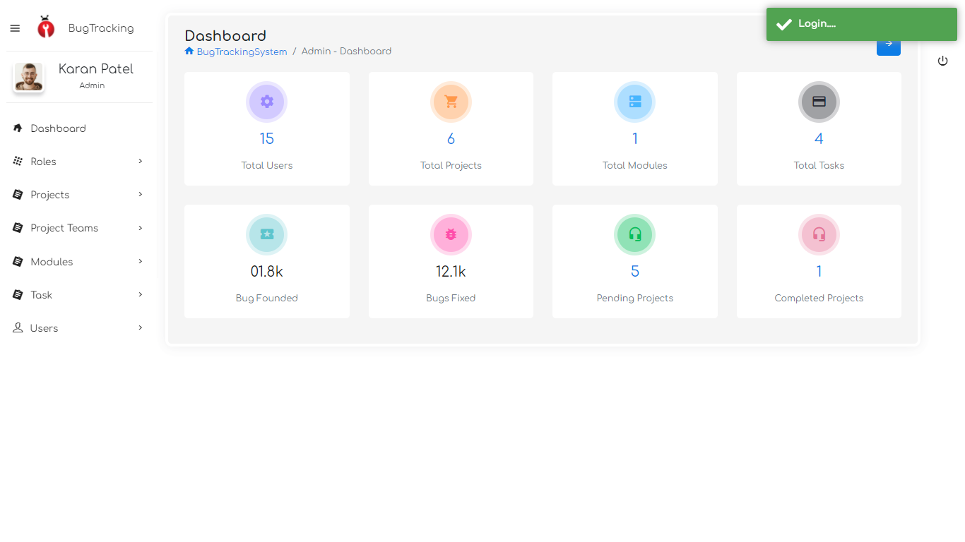

Slide 34
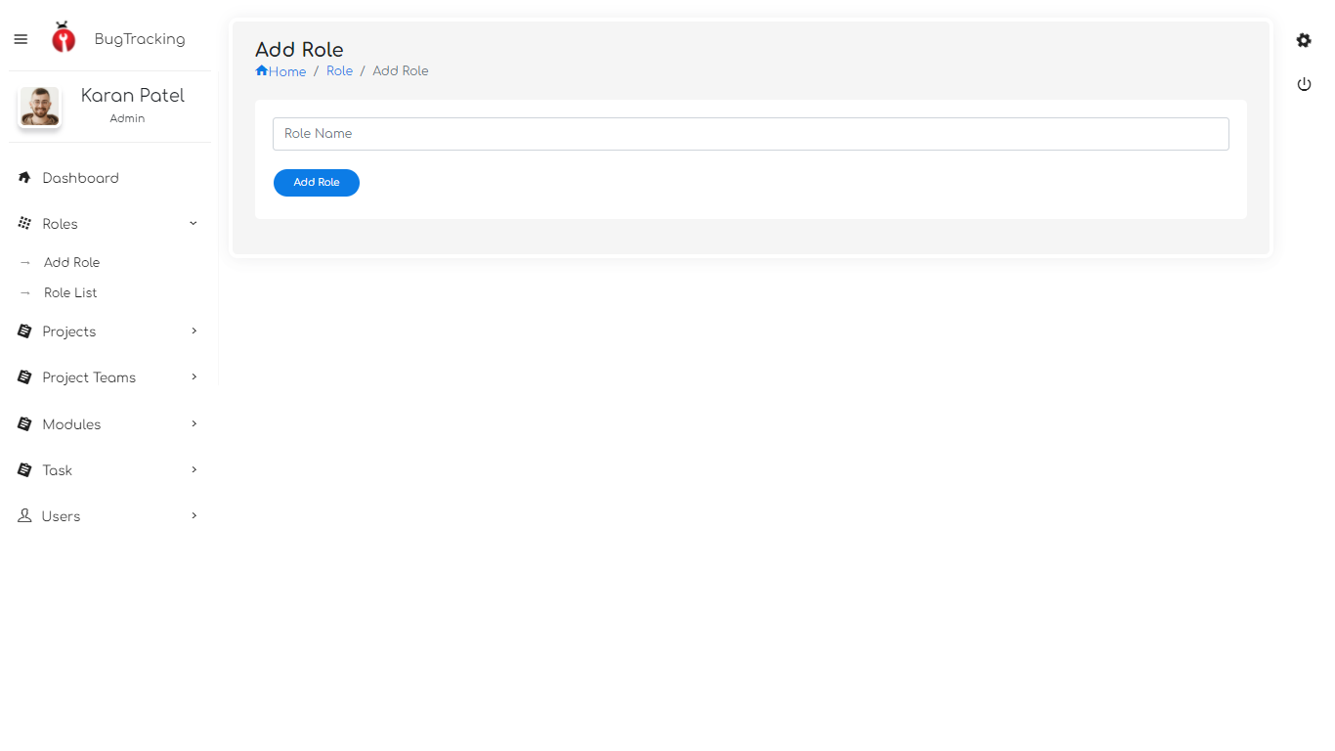

Slide 35
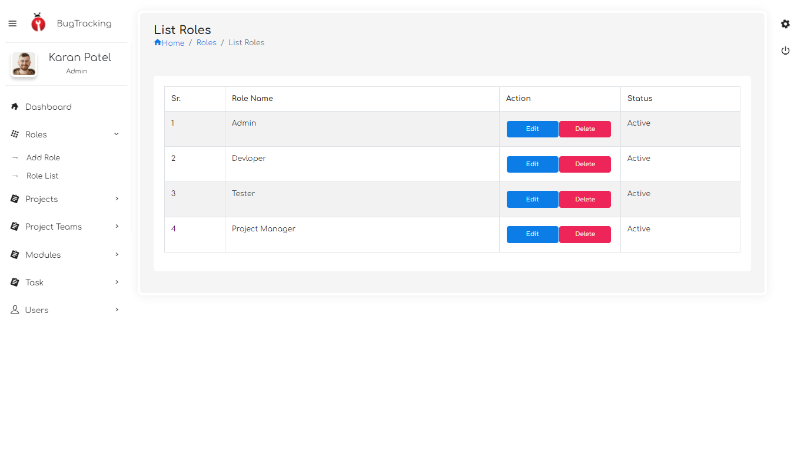

Slide 36
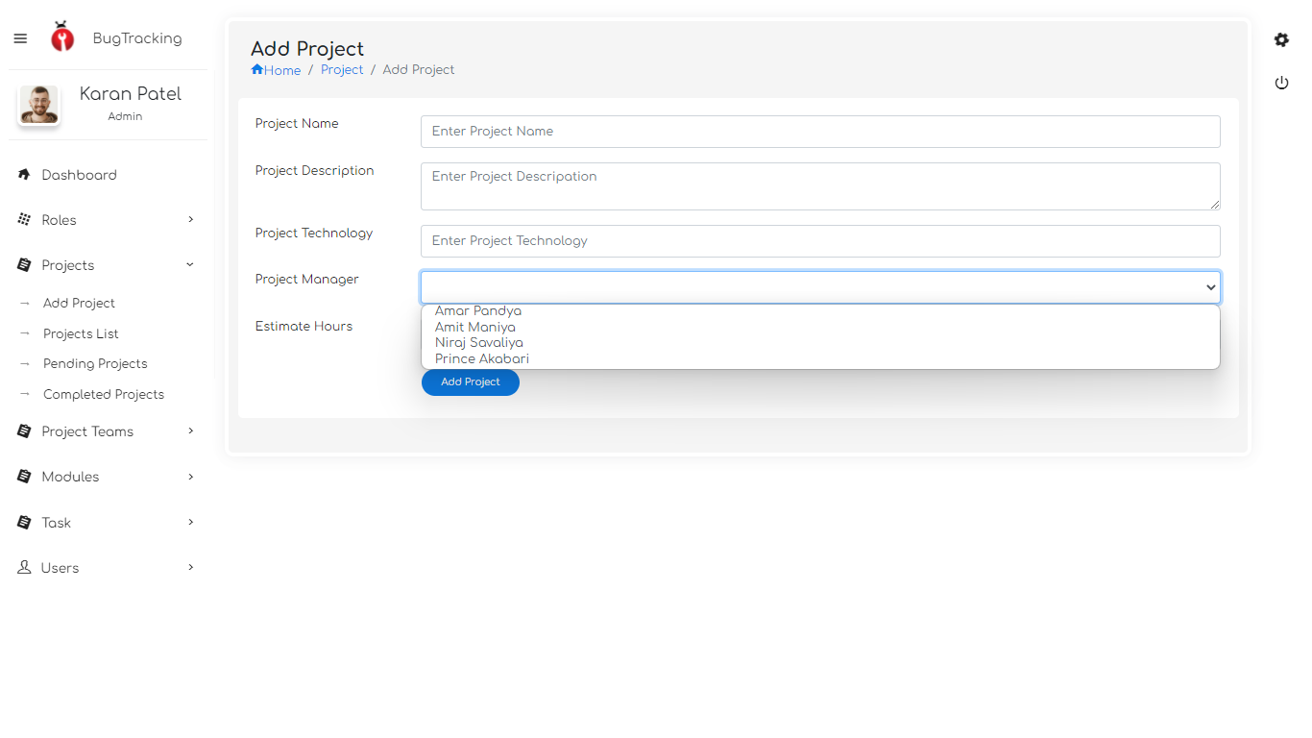

Slide 37
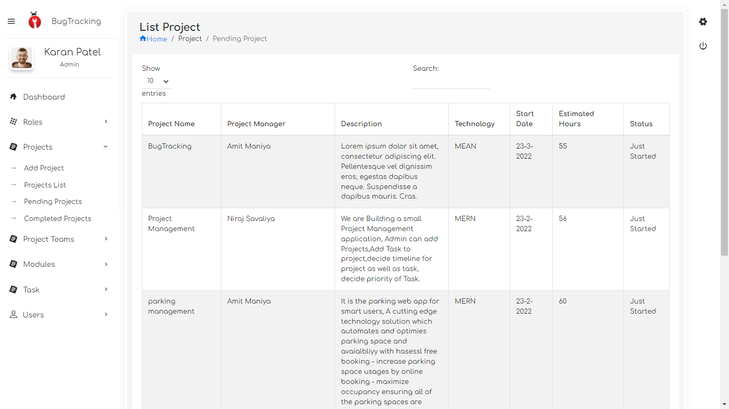

Slide 38
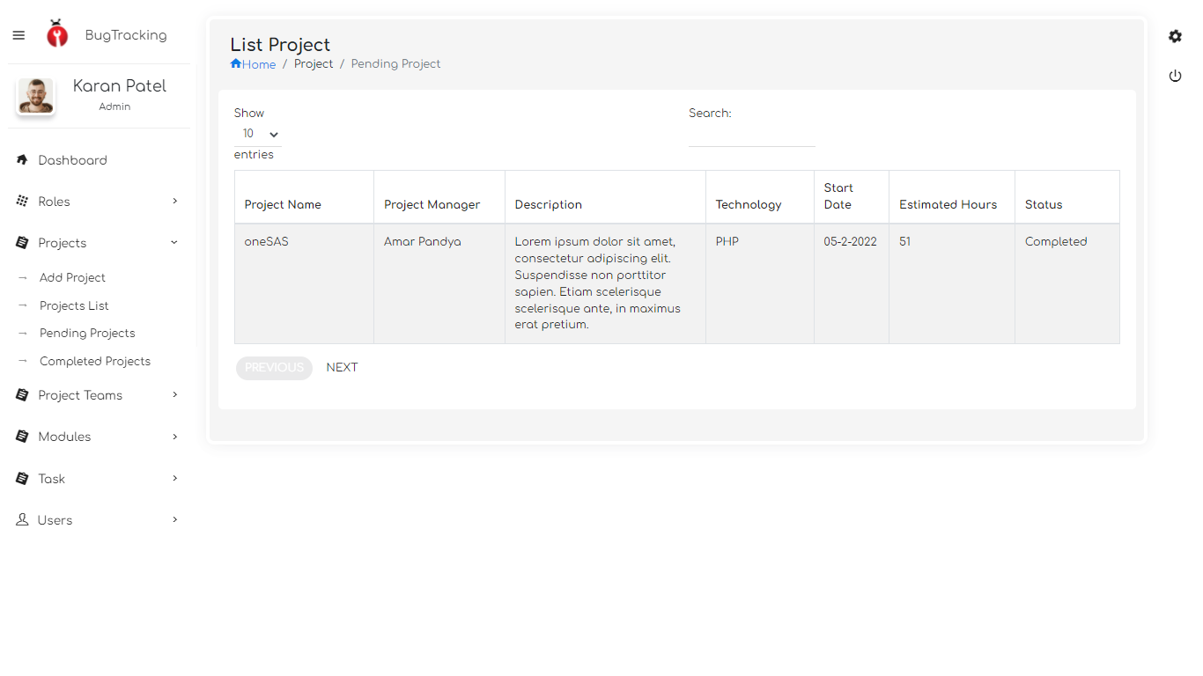

Slide 39
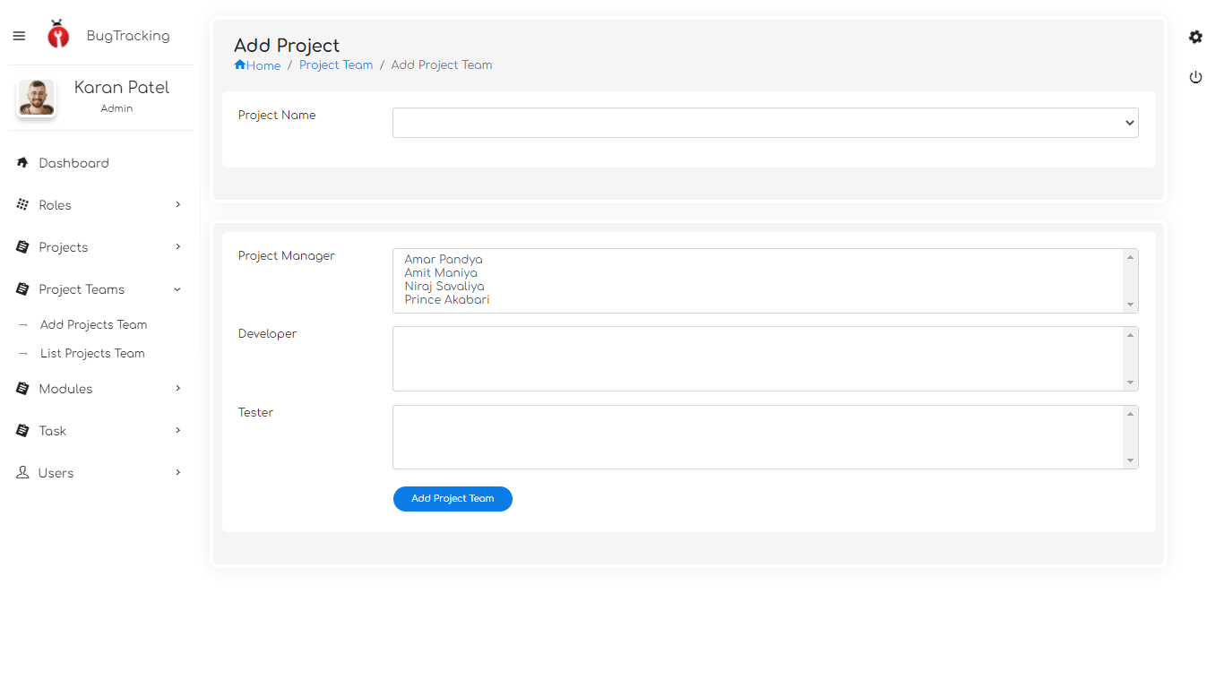

Slide 40
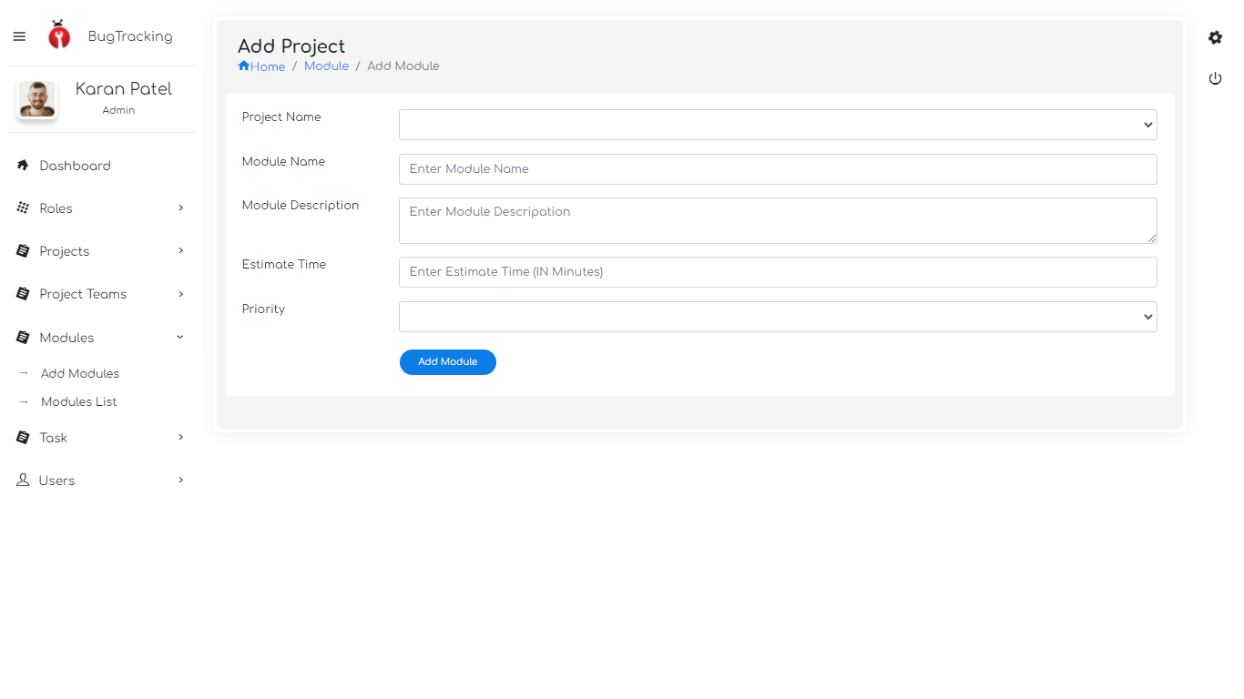

Slide 41
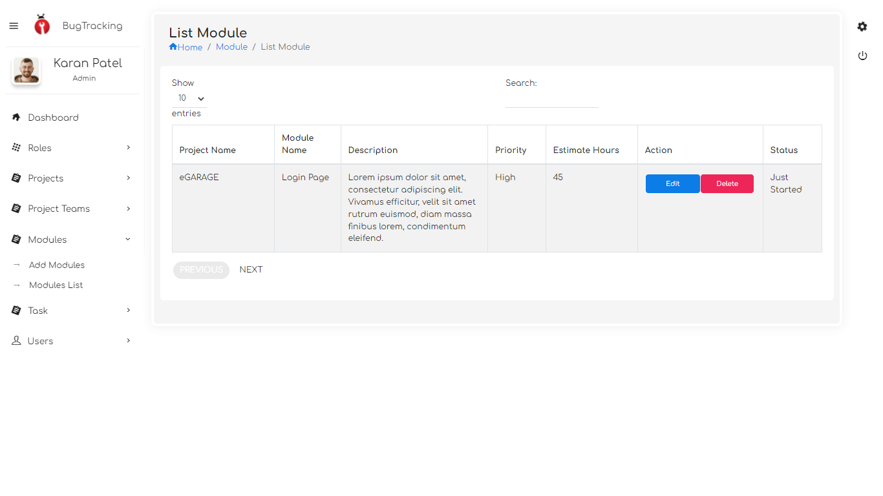

Slide 42
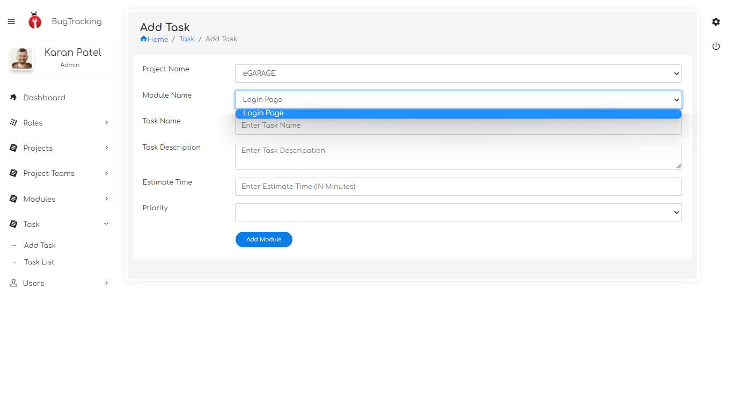

Slide 43
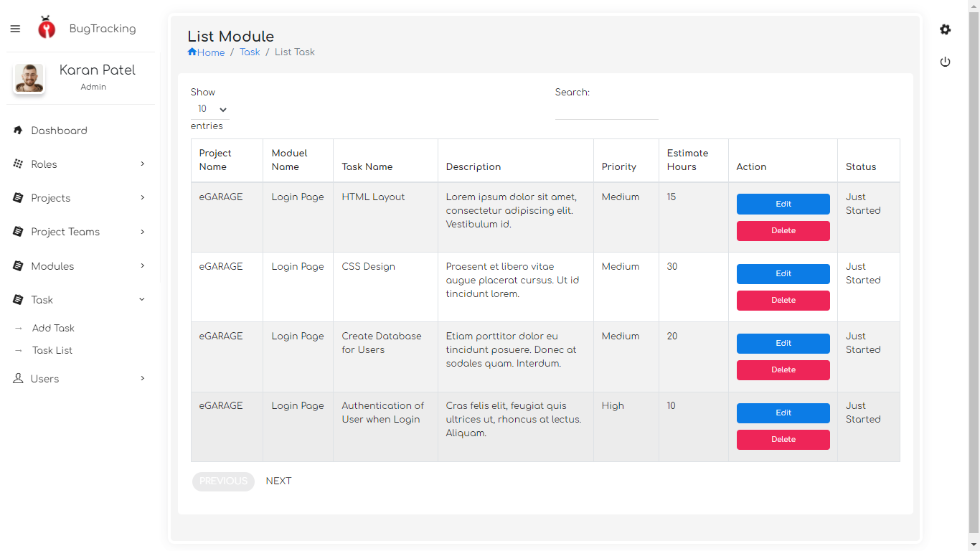

Slide 44
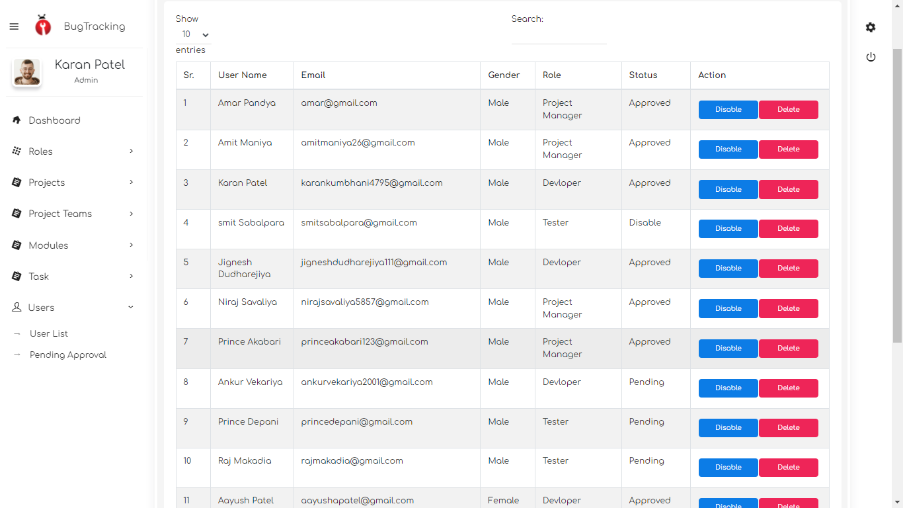

Slide 45
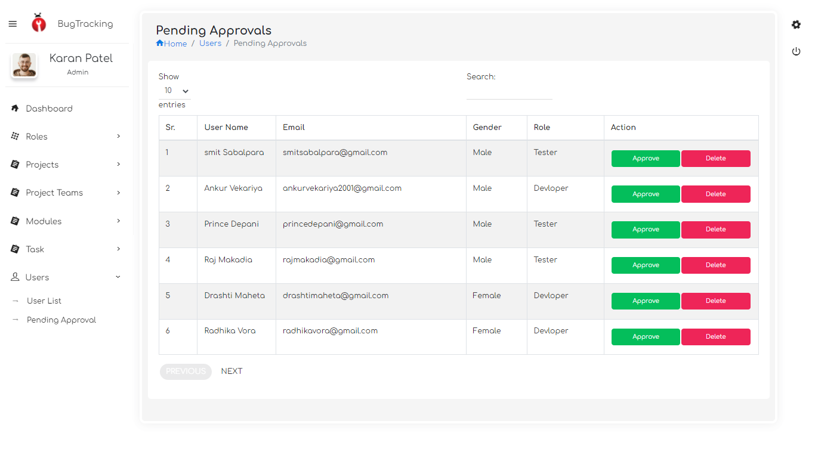

Slide 46
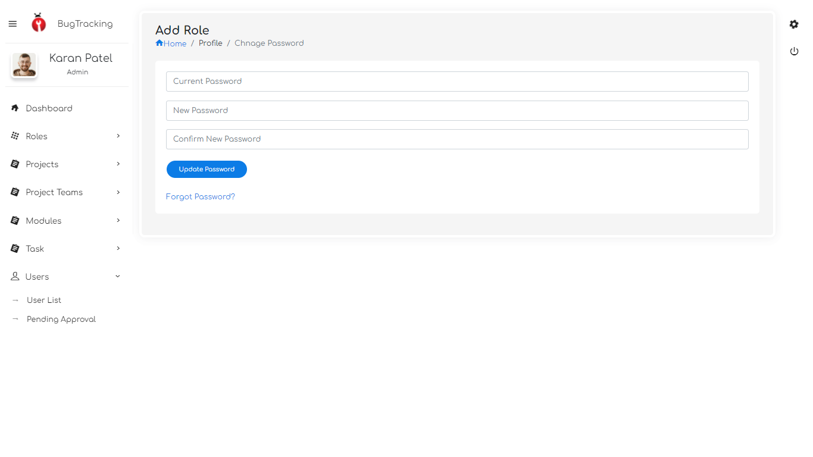

Slide 47
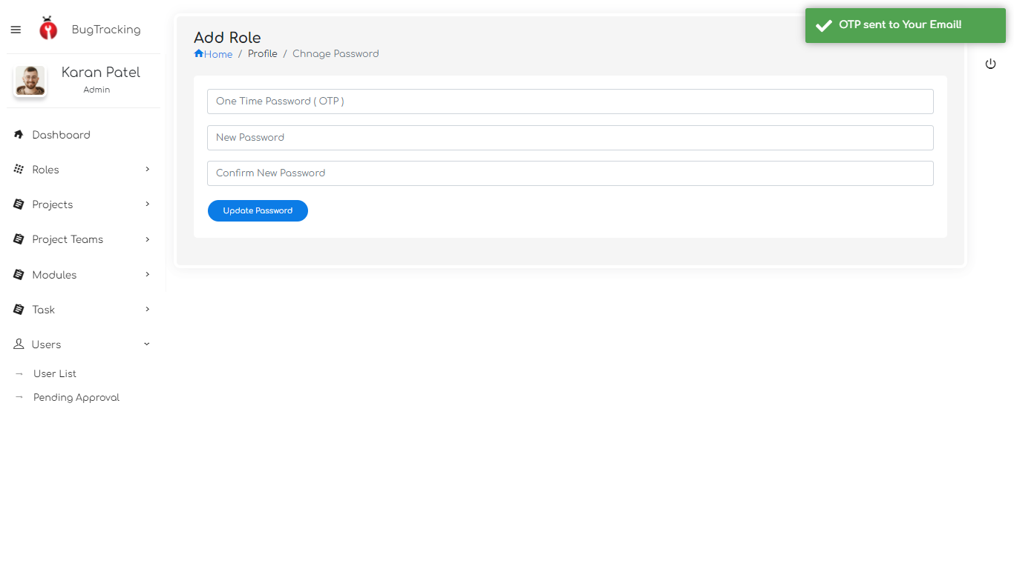

Slide 48

Thank you

